Slide 1
More General
Need different response curves for each predictor
Need more complex responses

Slide 2
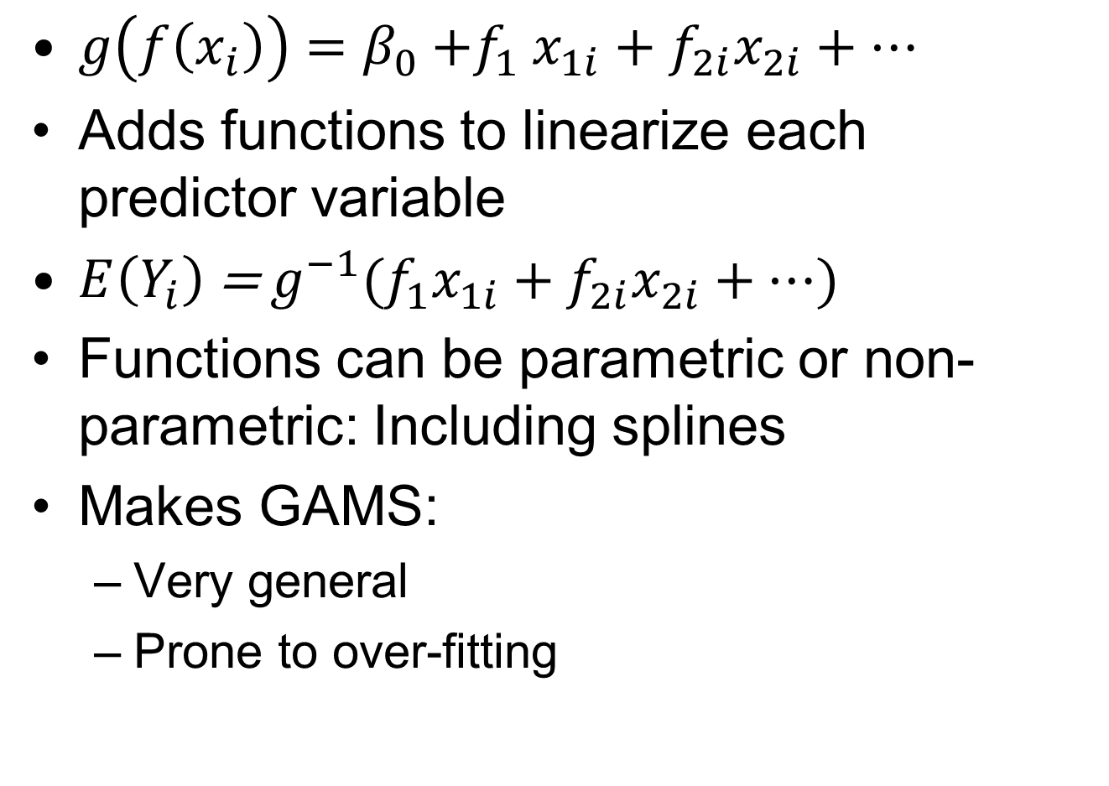
Generalized Additive Models
$g\left(f\left(x_{i}\right)\right)=β_{0}{+f}_{1}x_{1i}+f_{2i}x_{2i}+…$
Adds functions to linearize each predictor variable
$E\left(Y_{i}\right)$ = $g^{−1}(f_{1}x_{1i}+f_{2i}x_{2i}+…$)
Functions can be parametric or non-parametric: Including splines
Makes GAMS:
  Very general
  Prone to over-fitting

Slide 3
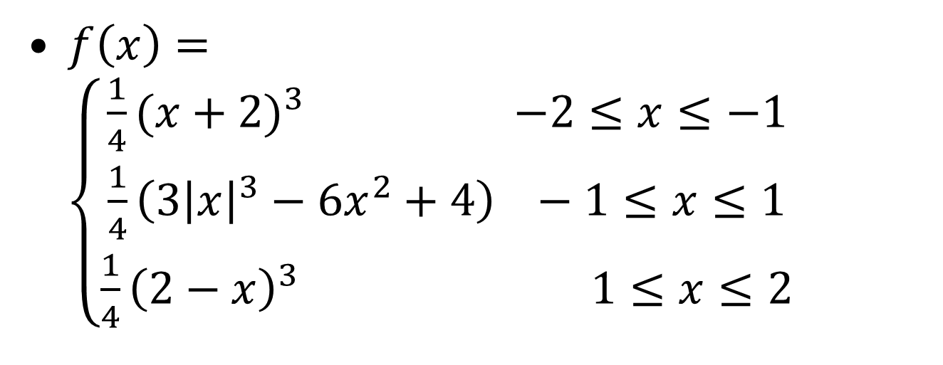
Spline Curves
$f\left(x\right)=\left\{\begin{matrix}\frac{1}{4}{(x+2)}^{3} −2≤x≤−1 \\ \frac{1}{4}\left(3{\left|x\right|}^{3}−6x^{2}+4\right) −1≤x≤1 \\ \frac{1}{4}{\left(2−x\right)}^{3} 1≤x≤2\end{matrix}\right.$
Knots
Bell-shaped Irwin-Hall spline

Slide 4
Spline Curves in R
Wrap predictors in a spline function:
  s(predictor)
Use “gamma” parameter to set the number of knots
  Controls over-fitting
  1.4 is recommended
In R:
  TheModel=gam(Height~s(AnnualPrecip), data=TheData,gamma=1.4)

Slide 5
Reading
When you have time:
  “The Elements of Statistical Learning” by Friedman
  Generalized Additive Models by Hastie and Tibshirani
For our next meeting (on web site):
  Jensen (crabs)

Slide 6
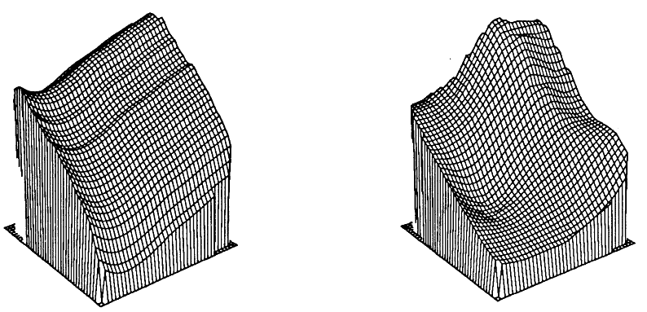
Which Approach?
GAM
Kernel Smoother
Age
Income
Age
Income
Z-axis shows the proportion of families with a telephone at home
Hastie and Tibshirani 1986, Generalized Additive Models

Slide 7
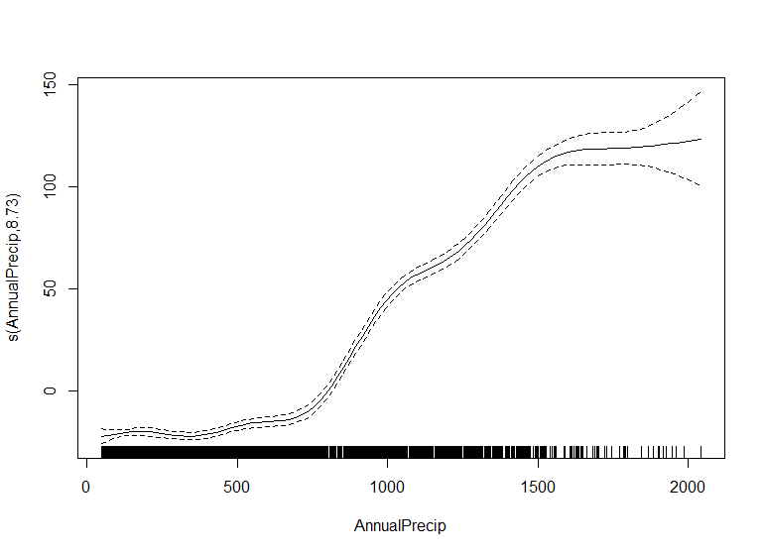
GAM Plots in R
“Partial” = 1 Covariate
Modeled Response Curve
95% CI
Sample point “Grass”
FIA Doug-Fir height data vs. BioClim Annual Precipitation

Slide 8
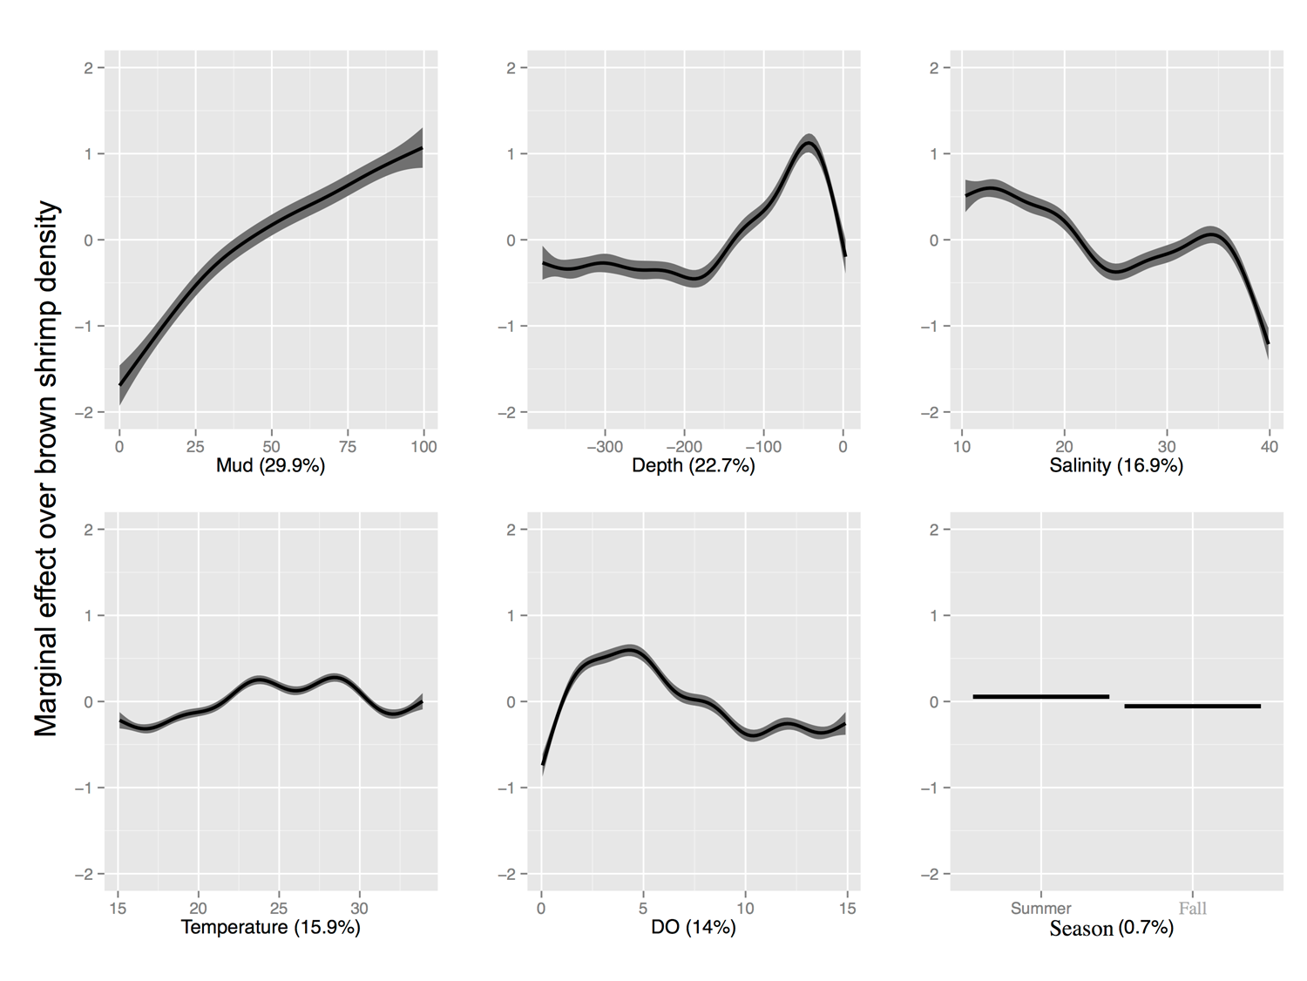
Brown Shrimp in GOM
Data from SeaMap and NOAA
Notes:
SeaMap Data, brown shrimp prefer muddy bottoms. Also, they spawn in shallow waters and then migrate to deeper water as they mature. The reason the density goes down as the depth goes to 0 is that the size of the net allows the smaller shrimp to escape.

Slide 9
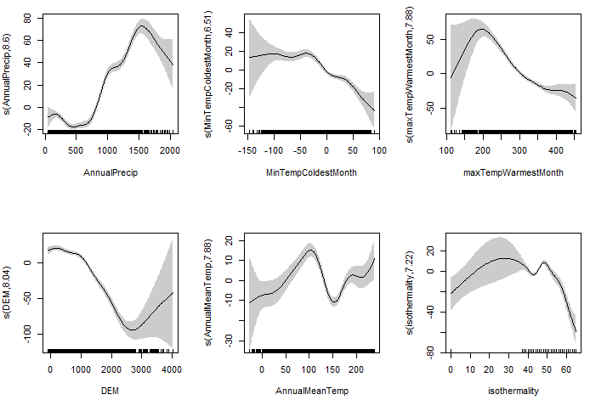
Gamma=1.4
Explained Deviance: 59%, AIC=57807
Data from FIA and BioClim
Notes:
Models for Doug-Fir in California from FIA data

Slide 10
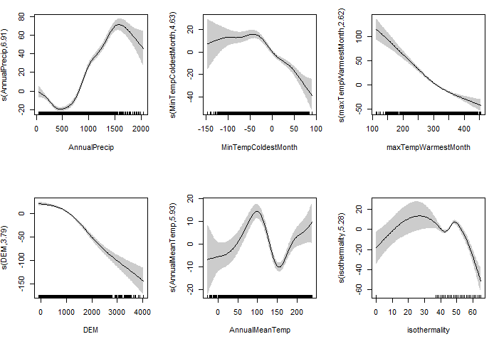
Gamma=10
Explained Deviance: 59%, AIC=57961
Data from FIA and BioClim

Slide 11
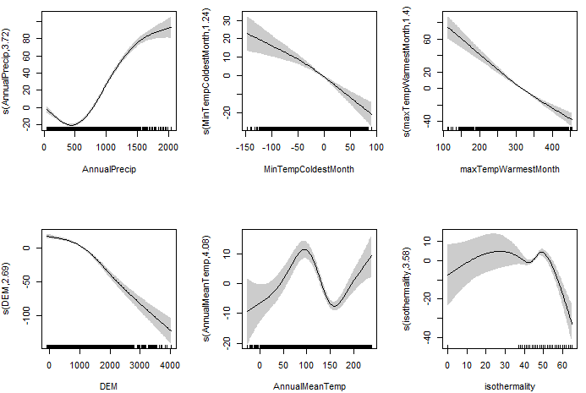
Gamma=20
Explained Deviance: 57%, AIC=58081
Data from FIA and BioClim

Slide 12
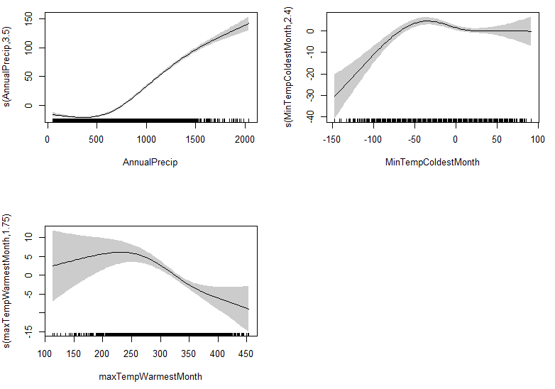
Gamma=20
Explained Deviance: 51%, AIC=58796
Data from FIA and BioClim

Slide 13
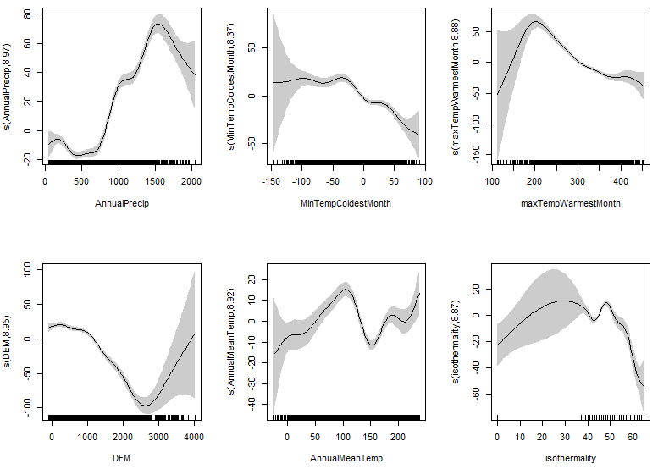
Gamma=0.1
Explained Deviance: 59%, AIC=57811
Data from FIA and BioClim

Slide 14
GAM Model Runs
Layers | Gamma | Explained Deviance | AIC
All 6 | 1.4 | 59 | 57807
All 6 | 10 | 58 | 57961
All 6 | 20 | 57 | 58081
Best 3 | 20 | 51 | 58796
All 6 | 0.1 | 59 | 57811

Slide 15
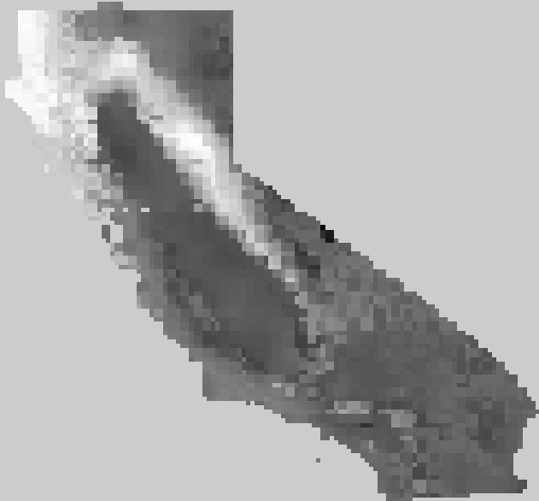
Best Model?
Best 3 predictors, gamma=20
Data from FIA and BioClim

Slide 16
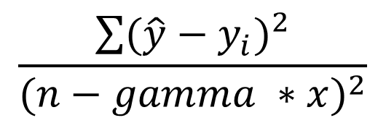
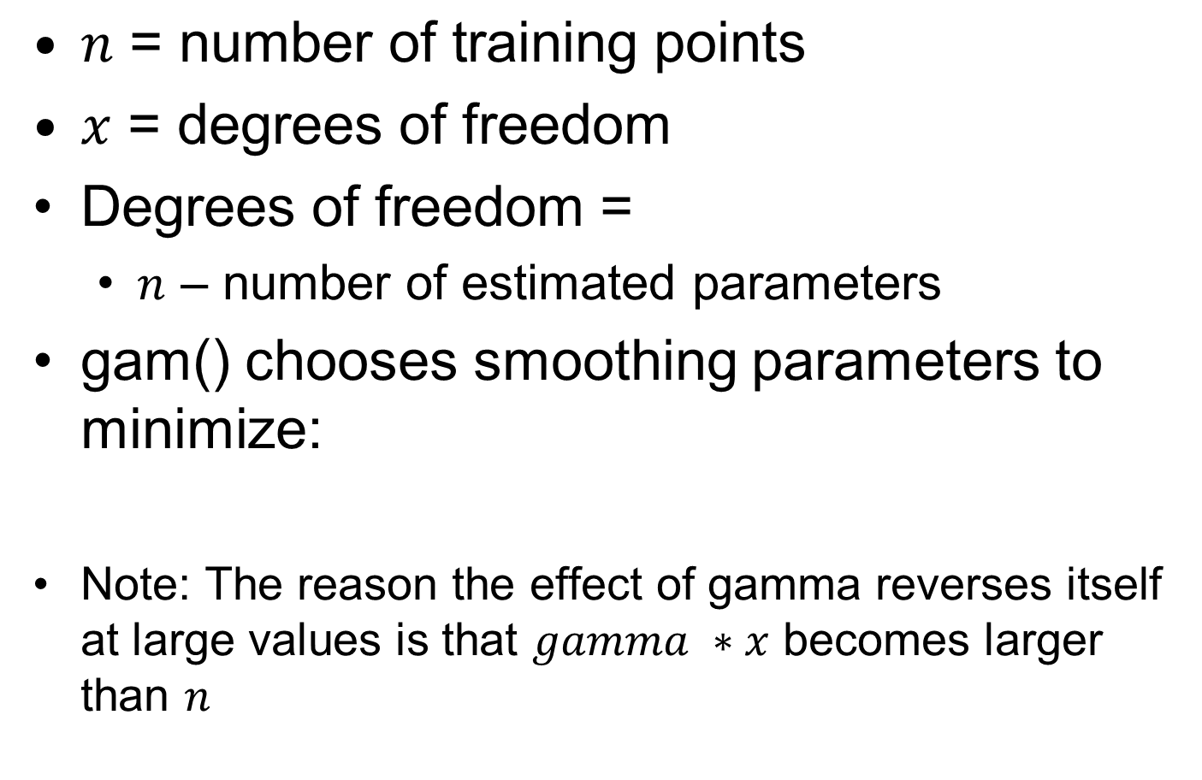
Gamma in GAMs
$n\text{ = }\text{number} \text{of} \text{training} \text{points}$
$x$ = degrees of freedom
Degrees of freedom =
  $n$ – number of estimated parameters
gam() chooses smoothing parameters to minimize:
Note: The reason the effect of gamma reverses itself at large values is that $gamma ∗x$ becomes larger than $n$
$$\frac{\sum{{(\hat{y}−y_{i})}^{2}}}{{(n−gamma ∗x)}^{2}}$$

Slide 17
Additional Resources
Generalized Additive Models: an introduction with R
  Copyrighted book
  Includes:
    Linear models
    GLMs
    GAMs
    Examples in R
    Some matrix algebra

Slide 18
Additional Resources
Geospatial Analysis with GAMs:
  http://www.casact.org/education/annual/2011/handouts/C3-Guszcza.pdf
Disease mapping using GAMs (workshop):
  http://www.cireeh.org/pmwiki.php/Main/Gam-mapWorkshop
Mapping population-based studies:
  http://www.ij-healthgeographics.com/content/5/1/26

